Slide 1
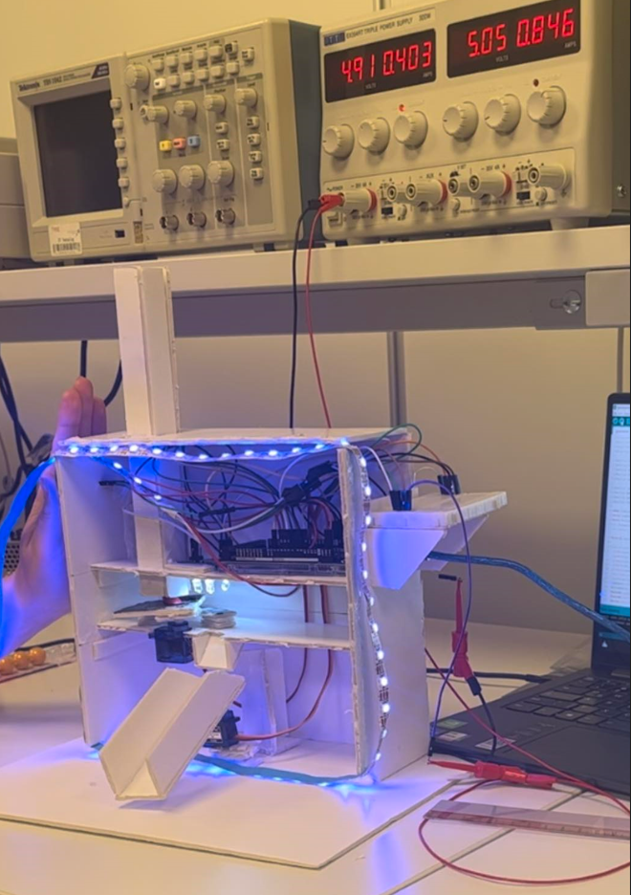
Touchless Candy Dispenser
Author: Justyna Kluska

Slide 2
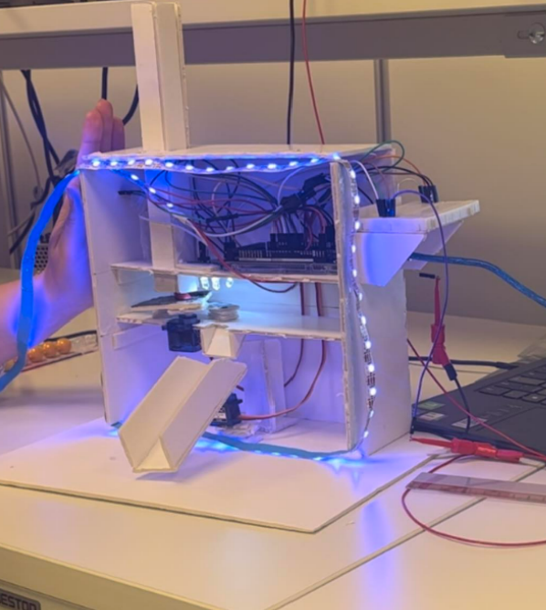
Product description
Touchless
Color-sorting function
Eye – catching
Unique combination of components

Slide 3
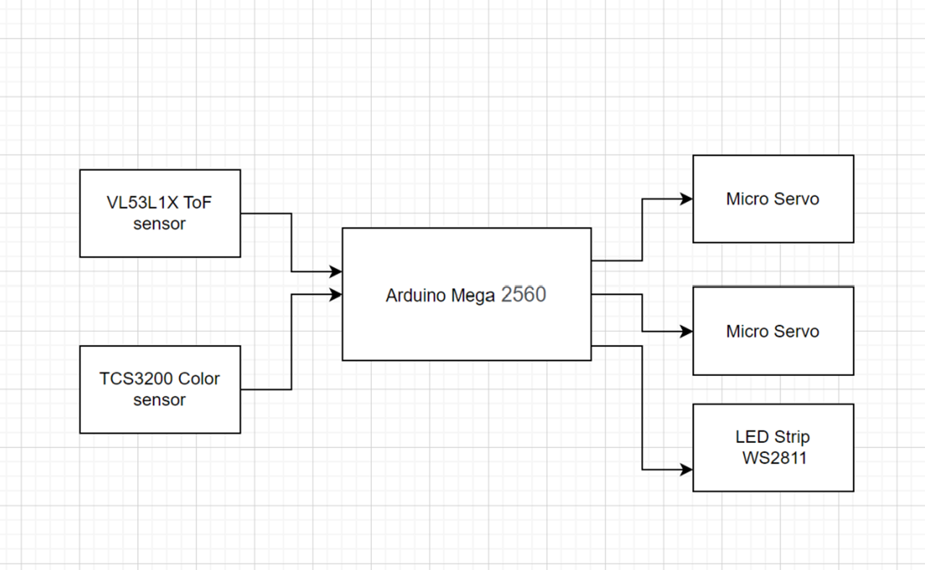

Slide 4
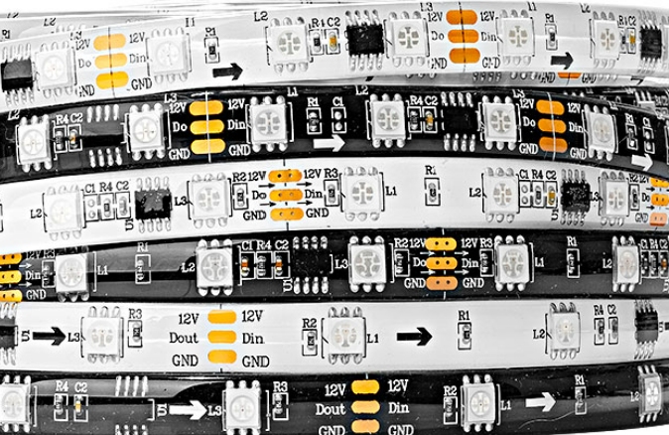
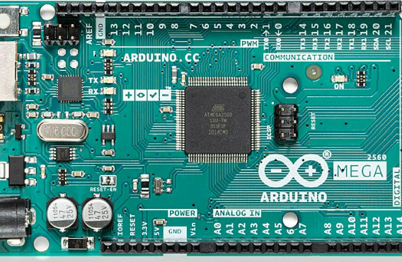
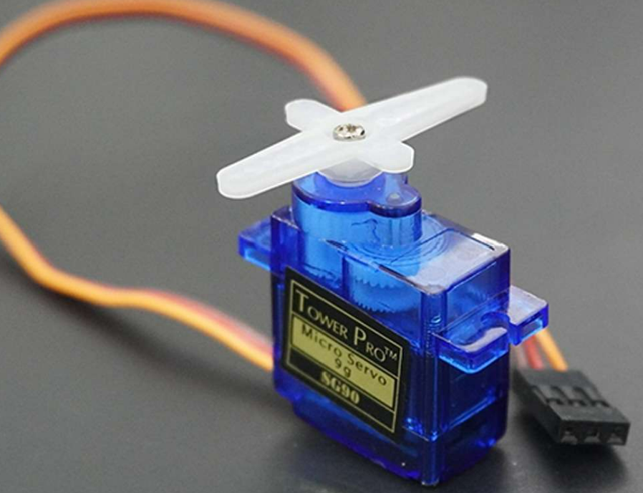
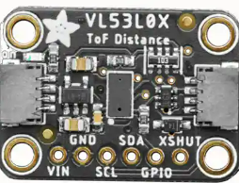
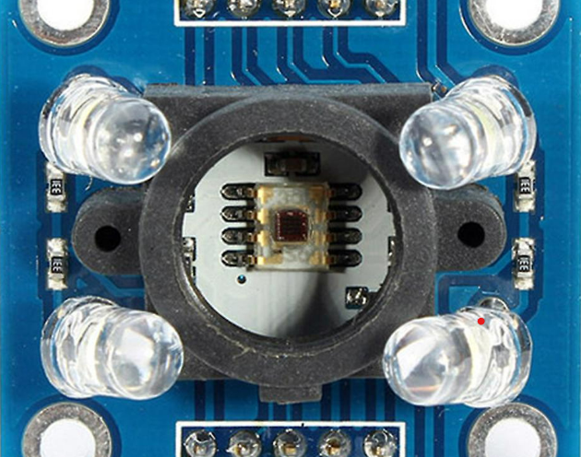

Slide 5
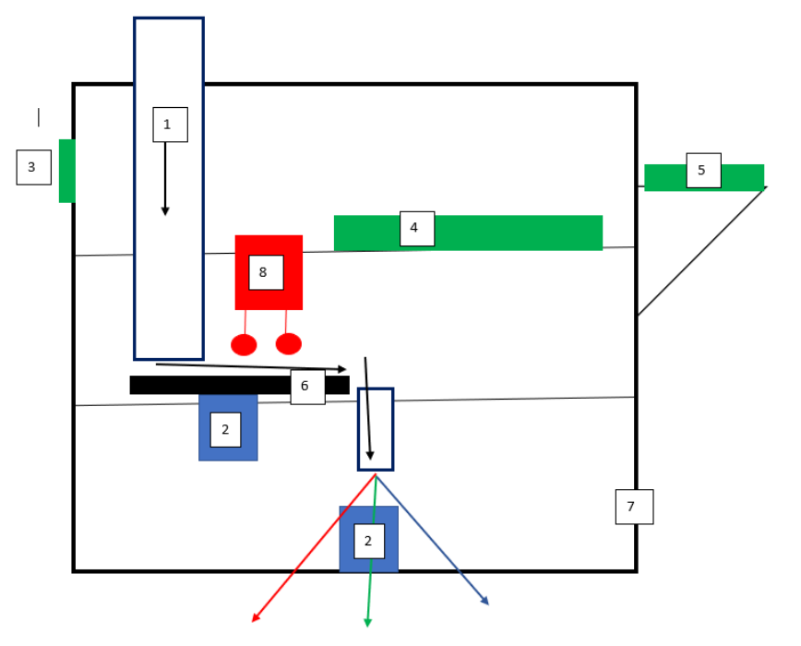

Slide 6
Code implementation
void loop() {
if (sensor.read() <= 100) { // Start the sorting process
servo.write(150); // starting positiom
delay(500);
for (int i = 150; i >= 65; i--) { // position of color sensor
}
delay(1000);
color = readColor();
delay(500);
switch (color) {
case 1:
servo1.write(45);
for (int i = 0; i < NUM_LEDS; i++) {
leds[i] = CRGB::Red; // Set the LED color to red
}
FastLED.show(); // turn LEDS with red
delay(500);
break;

Slide 7
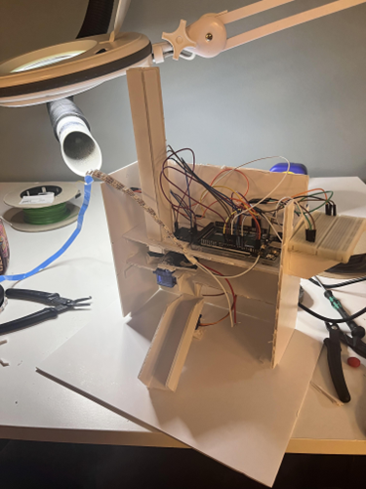
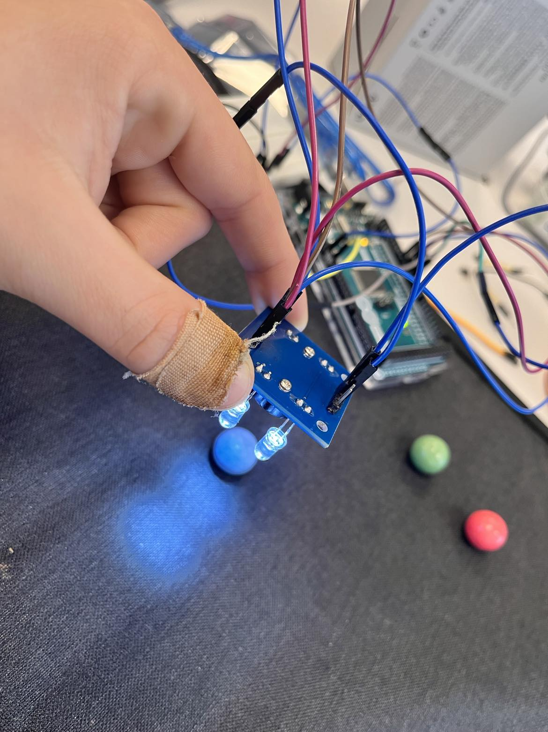
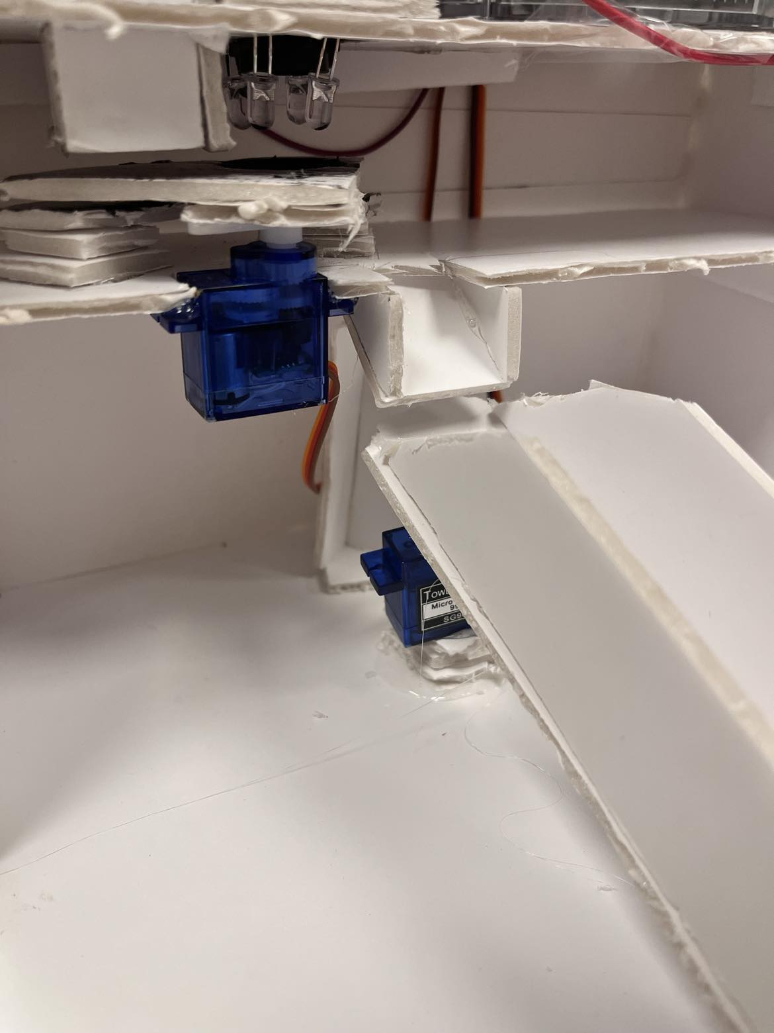
By incorporating a distance sensor, color sensor, and two micro servos, I developed a system to sort candy by color using C++ programming. The Arduino microcontroller executed the code effectively. To provide a visual indication, LED stripes were installed to display the detected color. The dispenser operates smoothly and accomplishes its intended purpose.

Slide 8

Challenges along the way
Adjusting and understanding the color sensor
Finding right type od candies
Hardware instalations

Slide 9

Future Perspectives
Adding more colors
Implementing tof sensor for every color’s tube
Preparing seperate tubes for different size’s of candies
Using solid material
Closing the box, revealing only distance sensor
Adjusting delays

Slide 10

Thank you for your attention

